Slide 1
Introduction to HTML

Slide 2
Timeline :History
HTML was created by Sir Tim Berners-Lee in late 1991 but was not released officially, published in 1995 as HTML 2.0.
HTML 4.01 was published in late 1999 and was a major version of HTML.

Slide 3
Timeline :History
HTML is evolving markup language and has evolved with various versions updating.
Long before its revised standards and specifications are carried in, each version has allowed its user to create web pages in a much easier and prettier way and make sites very efficient.

Slide 4
Timeline :History
HTML 1.0 was released in 1993 with the intention of sharing information that can be readable and accessible via web browsers.
But not many of the developers were involved in creating websites. So the language was also not growing.
Then comes the HTML 2.0, published in 1995, which contains all the features of HTML 1.0 along with that few additional features, which remained as the standard markup language for designing and creating websites until January 1997 and refined various core features of HTML.

Slide 5
Timeline :History
Then comes the HTML 3.0, where Dave Raggett who introduced a fresh paper or draft on HTML.
It included improved new features of HTML, giving more powerful characteristics for webmasters in designing web pages. But these powerful features of new HTML slowed down the browser in applying further improvements.
Then comes HTML 4.01, which is widely used and was a successful version of HTML before HTML 5.0, which is currently released and used worldwide.
HTML 5 can be said for an extended version of HTML 4.01, which was published in the year 2012.

Slide 6
Key Points :HTML
HTML (Hypertext Markup Language) is the only markup language for creating web pages. It provides some titles, headings, paragraphs, lists, tables, embedded images, etc., to describe the structure of text-based and multimedia information in HTML documents.
Here is some key information to easily describe HTML:
HTML (Hypertext Markup Language) is a language for publishing text-based and multimedia information on the World Wide Web.
HTML is a straightforward Computer Coding Language. It was developed in the 90s. HTML is the basis of a web page, and the web page is the basis of a website. HTML uses 'tags' to create web documents.
HTML is a hypertext markup language; It is a predetermined set of markup tags used to design web pages.

Slide 7
Key Points :HTML
HTML is the first language of web designing. CSS is also used along with HTML to improve web page design further. JavaScript is used with HTML to make web pages dynamic.
HTML is relatively easy to learn because every tag is predefined, so only we need to know the work of tags and their attributes.
Web browsers (Chrome, Internet Explorer, Firefox, Safari, and other web browsers) are software' to read HTML and display web page design as output.
You can write HTML in any simple editor such as Notepad. And other software such as Adobe Dreamweaver, Sublime, NetBeans, Notepad ++, etc., are mainly used for writing and editing HTML.
".html" or ".htm" are the two extensions used to write and save HTML files; we can write HTML code in any text editor and save it as "filename.html" or "filename.htm".

Slide 8
HTML:Tags
The essence of HTML programming is tags
A tag is a keyword enclosed by angle brackets ( Example: <I> )
There are opening and closing tags for many but not all tags; The affected text is between the two tags

Slide 9
HTML :Tags
The opening and closing tags use the same command except the closing tag contains and additional forward slash /
For example, the expression <B> Warning </B> would cause the word ‘Warning’ to appear in bold face on a Web page

Slide 10
Nested Tags
Whenever you have HTML tags within other HTML tags, you must close the nearest tag first
Example:
<H1> <I> The Nation </I> </H1>

Slide 11
Structure of a Web Page
All Web pages share a common structure
All Web pages should contain a pair of <HTML>, <HEAD>, <TITLE>, and <BODY> tags
<HTML>
<HEAD>
<TITLE> Example </TITLE>
</HEAD>
<BODY>
This is where you would include the text and images on your Web page.
</BODY>
</HTML>

Slide 12
The <TITLE> Tag
Choose the title of your Web page carefully; The title of a Web page determines its ranking in certain search engines
The title will also appear on Favorite lists, History lists, and Bookmark lists to identify your page

Slide 13
Text Formatting
Manipulating text in HTML can be tricky; Oftentimes, what you see is NOT what you get
For instance, special HTML tags are needed to create paragraphs, move to the next line, and create headings

Slide 14
Text Formatting Tags
<B> Bold Face </B>
<I> Italics </I>
<U> Underline </U>
<P> New Paragraph </P>
<BR> Next Line

Slide 15
Changing the Font
The expression <FONT FACE = “fontname”> … </FONT> can be used to change the font of the enclosed text
To change the size of text use the expression <FONT SIZE=n> …. </FONT> where n is a number between 1 and 7

Slide 16
Changing the Font
To change the color, use <FONT COLOR=“red”>…. </FONT>; The color can also be defined using hexadecimal representation ( Example: #ffffff )
These attributes can be combined to change the font, size, and color of the text all at once; For example, <FONT SIZE=4 FACE=“Courier” COLOR=“red”> …. </FONT>

Slide 17
Headings
Web pages are typically organized into sections with headings; To create a heading use the expression <Hn>….</Hn> where n is a number between 1 and 7
In this case, the 1 corresponds to the largest size heading while the 7 corresponds to the smallest size

Slide 18
Aligning Text
The ALIGN attribute can be inserted in the <P> and <Hn> tags to right justify, center, or left justify the text
For example, <H1 ALIGN=CENTER> The New York Times </H1> would create a centered heading of the largest size

Slide 19
Comment Statements
Comment statements are notes in the HTML code that explain the important features of the code
The comments do not appear on the Web page itself but are a useful reference to the author of the page and other programmers
To create a comment statement use the <!-- …. --> tags

Slide 20
The Infamous Blink Tag
It is possible to make text blink using the <BLINK> … </BLINK> tag
However, it is best to use this feature at most sparingly or not at all; What seems like a good idea to a Web designer can become very annoying to a Web user
The <BLINK> tag is not supported by Internet Explorer

Slide 21
Page Formatting
To define the background color, use the BGCOLOR attribute in the <BODY> tag
To define the text color, use the TEXT attribute in the <BODY> tag
To define the size of the text, type <BASEFONT SIZE=n>

Slide 22
Example
<HTML>
<HEAD>
<TITLE> Example </TITLE>
</HEAD>
<BODY BGCOLOR=“black” TEXT=“white”>
<BASEFONT SIZE=7>
This is where you would include the text and images on your Web page.
</BODY>
</HTML>

Slide 23
Inserting Images
Type <IMG SRC = “image.jpg”>, where image.jpg indicates the location of the image file
The WIDTH=n and HEIGHT=n attributes can be used to adjust the size of an image
The attribute BORDER=n can be used to add a border n pixels thick around the image

Slide 24
Alternate Text
Some browsers don’t support images. In this case, the ALT attribute can be used to create text that appears instead of the image.
Example:
<IMG SRC=“satellite.jpg” ALT = “Picture of satellite”>

Slide 25
Links
A link lets you move from one page to another, play movies and sound, send email, download files, and more….
A link has three parts: a destination, a label, and a target
To create a link type
<A HREF=“page.html”> label </A>

Slide 26
Anatomy of a Link
<A HREF=“page.html”> label </A>
In the above link, “page.html” is the destination. The destination specifies the address of the Web page or file the user will access when he/she clicks on the link.
The label is the text that will appear underlined or highlighted on the page

Slide 27
Example: Links
To create a link to CNN, I would type:
<A HREF=“http://www.cnn.com”>CNN</A>
To create a link to MIT, I would type:
<A HREF=“http://www.mit.edu”>MIT</A>

Slide 28
Changing the Color of Links
The LINK, VLINK, and ALINK attributes can be inserted in the <BODY> tag to define the color of a link
LINK defines the color of links that have not been visited
VLINK defines the color of links that have already been visited
ALINK defines the color of a link when a user clicks on it

Slide 29
Using Links to Send Email
To create a link to an email address, type <A HREF=“mailto:email_address”> Label</A>
For example, to create a link to send email to myself, I would type: <A HREF=“mailto: ktdunn@mit.edu”>email Katie Dunn</A>

Slide 30
Anchors
Anchors enable a user to jump to a specific place on a Web site
Two steps are necessary to create an anchor. First you must create the anchor itself. Then you must create a link to the anchor from another point in the document.

Slide 31
Anchors
To create the anchor itself, type <A NAME=“anchor name”>label</A> at the point in the Web page where you want the user to jump to
To create the link, type <A HREF=“#anchor name”>label</A> at the point in the text where you want the link to appear

Slide 32
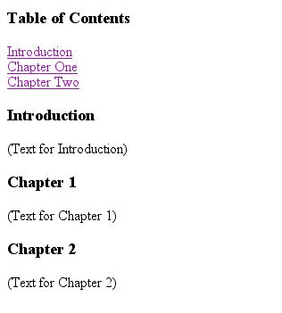
Example: Anchor
<A HREF="#chap2">Chapter Two</A><BR>
Link
<A NAME="chap2">Chapter 2 </A>
Anchor

Slide 33

Ordered Lists
Ordered lists are a list of numbered items.
To create an ordered list, type:
<OL>
<LI> This is step one.
<LI> This is step two.
<LI> This is step three.
</OL>
Here’s how it would look on the Web:

Slide 34
More Ordered Lists….
The TYPE=x attribute allows you to change the the kind of symbol that appears in the list.
A is for capital letters
a is for lowercase letters
I is for capital roman numerals
i is for lowercase roman numerals

Slide 35

Unordered Lists
An unordered list is a list of bulleted items
To create an unordered list, type:
<UL>
<LI> First item in list
<LI> Second item in list
<LI> Third item in list
</UL>
Here’s how it would look on the Web:

Slide 36
More Unordered Lists...
The TYPE=shape attribute allows you to change the type of bullet that appears
circle corresponds to an empty round bullet
square corresponds to a square bullet
disc corresponds to a solid round bullet; this is the default value

Slide 37
Forms
What are forms?
An HTML form is an area of the document that allows users to enter information into fields.
A form may be used to collect personal information, opinions in polls, user preferences and other kinds of information.

Slide 38
Forms
There are two basic components of a Web form: the shell, the part that the user fills out, and the script which processes the information
HTML tags are used to create the form shell. Using HTML you can create text boxes, radio buttons, checkboxes, drop-down menus, and more...

Slide 39
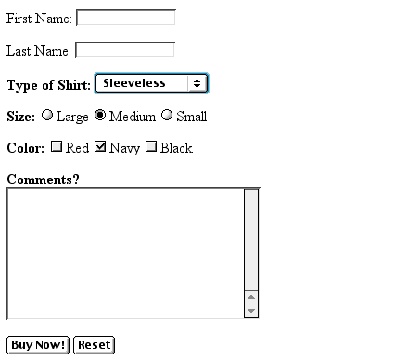
Example: Form
Text Box
Drop-down Menu
Radio Buttons
Checkboxes
Text Area
Reset Button
Submit Button

Slide 40
Creating Text Boxes
To create a text box, type <INPUT TYPE=“text” NAME=“name” VALUE=“value” SIZE=n MAXLENGTH=n>
The NAME, VALUE, SIZE, and MAXLENGTH attributes are optional

Slide 41
Text Box Attributes
The NAME attribute is used to identify the text box to the processing script
The VALUE attribute is used to specify the text that will initially appear in the text box
The SIZE attribute is used to define the size of the box in characters
The MAXLENGTH attribute is used to define the maximum number of characters that can be typed in the box

Slide 42

Example: Text Box
First Name: <INPUT TYPE="text" NAME="FirstName" VALUE="First Name" SIZE=20>
<BR><BR>
Last Name: <INPUT TYPE="text" NAME="LastName" VALUE="Last Name" SIZE=20>
<BR><BR>
Here’s how it would look on the Web:

Slide 43
Creating Larger Text Areas
To create larger text areas, type <TEXTAREA NAME=“name” ROWS=n1 COLS=n2 WRAP> Default Text </TEXTAREA>, where n1 is the height of the text box in rows and n2 is the width of the text box in characters
The WRAP attribute causes the cursor to move automatically to the next line as the user types

Slide 44
Example: Text Area
<B>Comments?</B>
<BR>
<TEXTAREA NAME="Comments" ROWS=10 COLS=50 WRAP>
</TEXTAREA>

Slide 45
Creating Radio Buttons
To create a radio button, type <INPUT TYPE=“radio” NAME=“name” VALUE=“data”>Label, where “data” is the text that will be sent to the server if the button is checked and “Label” is the text that identifies the button to the user

Slide 46
Example: Radio Buttons
<B> Size: </B>
<INPUT TYPE="radio" NAME="Size"
VALUE="Large">Large
<INPUT TYPE="radio" NAME="Size"
VALUE="Medium">Medium
<INPUT TYPE="radio" NAME="Size"
VALUE="Small">Small

Slide 47
Creating Checkboxes
To create a checkbox, type <INPUT TYPE=“checkbox” NAME=“name” VALUE=“value”>Label
If you give a group of radio buttons or checkboxes the same name, the user will only be able to select one button or box at a time

Slide 48
Example: Checkboxes
<B> Color: </B>
<INPUT TYPE="checkbox" NAME="Color" VALUE="Red">Red
<INPUT TYPE="checkbox" NAME="Color"
VALUE="Navy">Navy
<INPUT TYPE="checkbox" NAME="Color"
VALUE="Black">Black

Slide 49
Creating Drop-down Menus
To create a drop-down menu, type <SELECT NAME=“name” SIZE=n MULTIPLE>
Then type <OPTION VALUE= “value”>Label
In this case the SIZE attribute specifies the height of the menu in lines and MULTIPLE allows users to select more than one menu option

Slide 50
Example: Drop-down Menu
<B>WHICH IS FAVOURITE FRUIT:</B>
<SELECT>
<OPTION VALUE="MANGOES">MANGOES
<OPTION VALUE="PAPAYA">PAPAYA
<OPTION VALUE="GUAVA">GUAVA
<OPTION VALUE="BANANA"> BANANA
<OPTION VALUE="PINEAPPLE">PINEAPPLE
</SELECT>

Slide 51
Creating a Submit Button
To create a submit button, type <INPUT TYPE=“submit”>
If you would like the button to say something other than submit, use the VALUE attribute
For example, <INPUT TYPE=“submit” VALUE=“Buy Now!”> would create a button that says “Buy Now!”

Slide 52
Creating a Reset Button
To create a reset button, type <INPUT TYPE=“reset”>
The VALUE attribute can be used in the same way to change the text that appears on the button

Slide 53
Tables
Tables can be used to display rows and columns of data, create multi-column text, captions for images, and sidebars
The <TABLE> tag is used to create a table; the <TR> tag defines the beginning of a row while the <TD> tag defines the beginning of a cell

Slide 54
Adding a Border
The BORDER=n attribute allows you to add a border n pixels thick around the table
To make a solid border color, use the BORDERCOLOR=“color” attribute
To make a shaded colored border, use BODERCOLORDARK=“color” and BORDERCOLORLIGHT=“color”

Slide 55

Creating Simple Table
<TABLE BORDER=10>
<TR>
<TD>One</TD>
<TD>Two</TD>
</TR>
<TR>
<TD>Three</TD>
<TD>Four</TD>
</TR>
</TABLE>
Here’s how it would look on the Web:

Slide 56
Adjusting the Width
When a Web browser displays a table, it often adds extra space. To eliminate this space use the WIDTH =n attribute in the <TABLE> and <TD> tags
Keep in mind - a cell cannot be smaller than its contents, and if you make a table wider than the browser window, users will not be able to see parts of it.

Slide 57
Centering a Table
There are two ways to center a table
Type <TABLE ALIGN=CENTER>
Enclose the <TABLE> tags in opening and closing <CENTER> tags

Slide 58
Wrapping Text around a Table
It is possible to wrap text around a table. This technique is often used to keep images and captions together within an article.
To wrap text around a table, type <TABLE ALIGN = LEFT> to align the table to the left while the text flows to the right.
Create the table using the <TR>, <TD>, and </TABLE> tags as you normally would

Slide 59
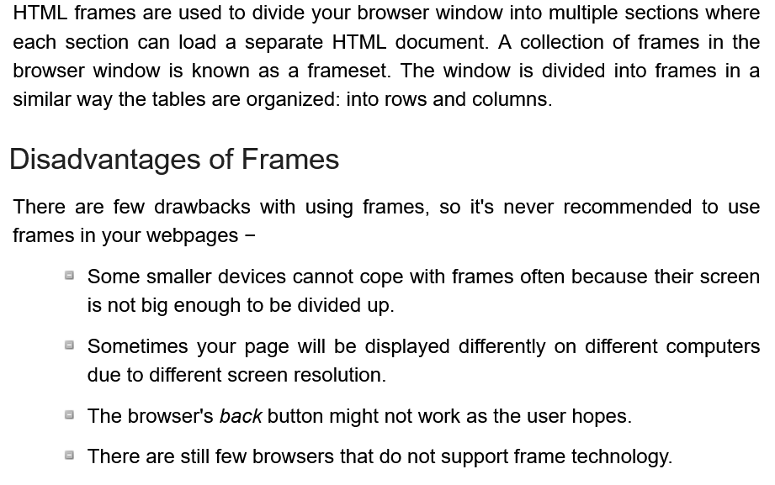
Frames

Slide 60
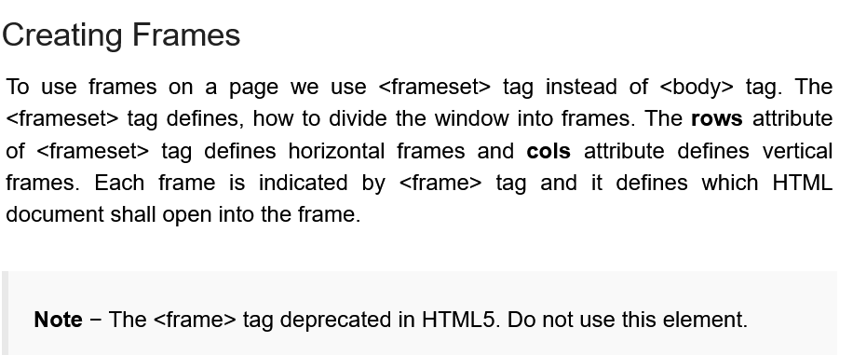
Frames

